Slide 1


Outfits tailored to you, by you

Slide 2


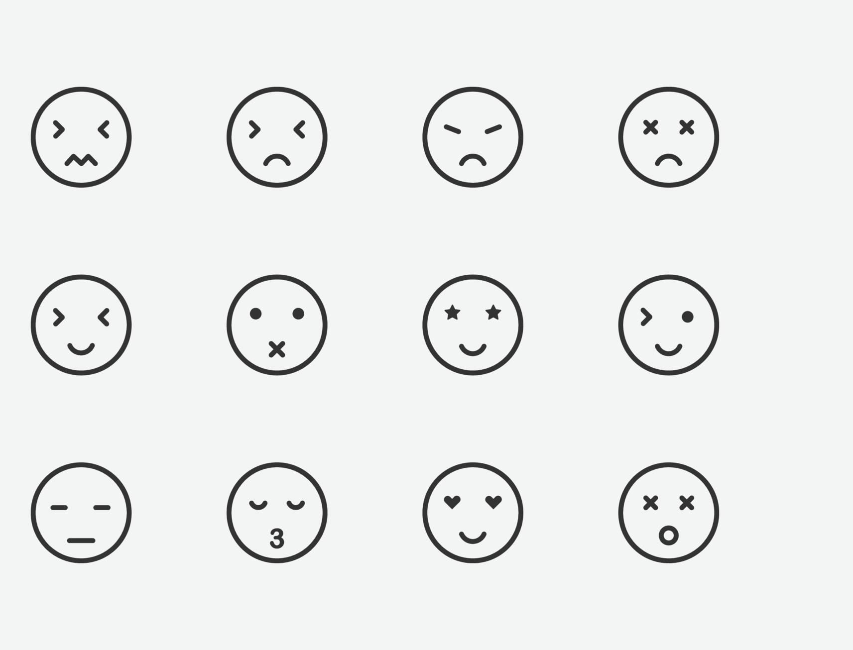
Mission Statement
Our mission is to revolutionize fashion with advanced technology that empowers women to effortlessly express their style. Our smart closet makes outfits based on personality, weather, and mood, saving time and reducing hassle. Join us in creating a world where fashion meets technology to make daily dressing effortless and enjoyable.

Slide 3

S.W.O.T Analysis
Strengths
Weaknesses
It's uniquely created for each customer.
It's a time saving option for customers.
This product will be using high technology to create outfits.
Streamline of products (clothes) for each season in the US.
It is limited to people with high income.
Time and money will go into this invention.
Clothes will not be provided, only held.
It has to be generated by a large amount of electricity for it to be used.

Slide 4
S.W.O.T Analysis
OPPORTUNITIES
THREATS
Growing demand for personalized fashion technology.
Potential to expand to other high-income markets.
Opportunity to partner with fashion brands and designers for collaborative projects.
Possibility of attracting investment from technology and fashion industries.
Up-to-date technology.
Hiring extra workers, contractors, getting investors
Unforeseen circumstances.
Not enough power for the technology to function properly.

Slide 5
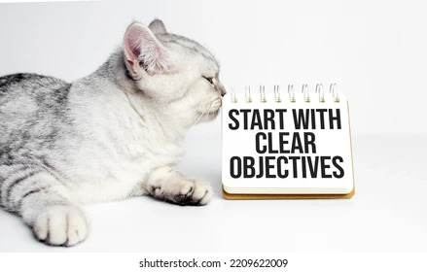



Objectives
Increase growth in sales and brand awareness.
Increase revenue by 25% within the next 12 months.
Implement effective marketing strategies, including partnerships with fashion influencers and sustainable fashion organizations.
Enhance customer satisfaction and loyalty.
Continually improve the product and service based on customer feedback.
Stay up to date with the latest technology trends.
Ensure Clotech remains relevant in a constantly evolving market.

Slide 6
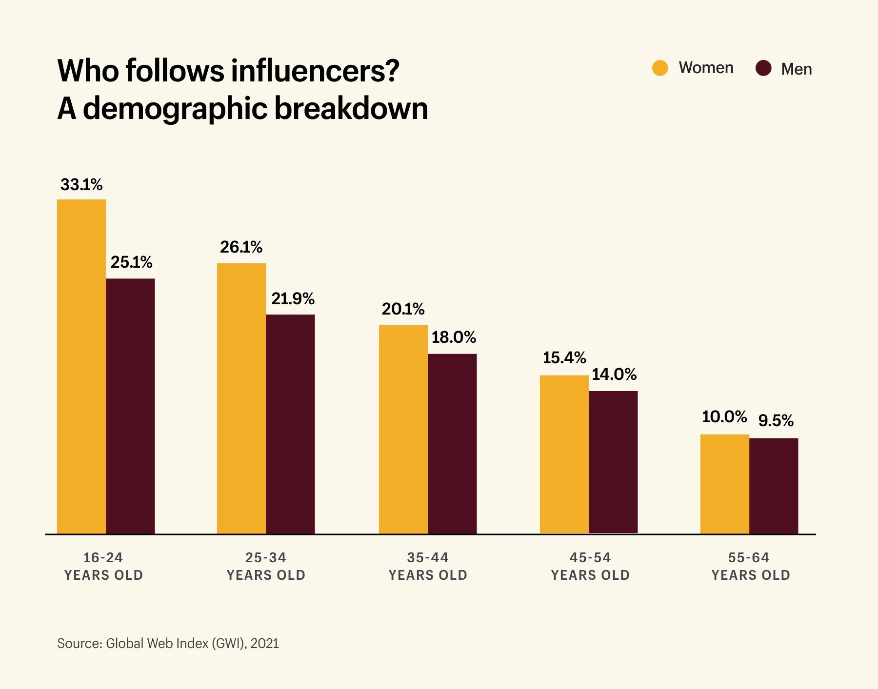
Target Market
Target audience: people aged 18-35 with high status, income, and influence.
Preferably based in Los Angeles, but nationwide reach is also a focus
Female audience within the target age range has a higher percentage of following influencers on social media.
Targeting this group will lead to higher business recognition and growth.

Slide 7
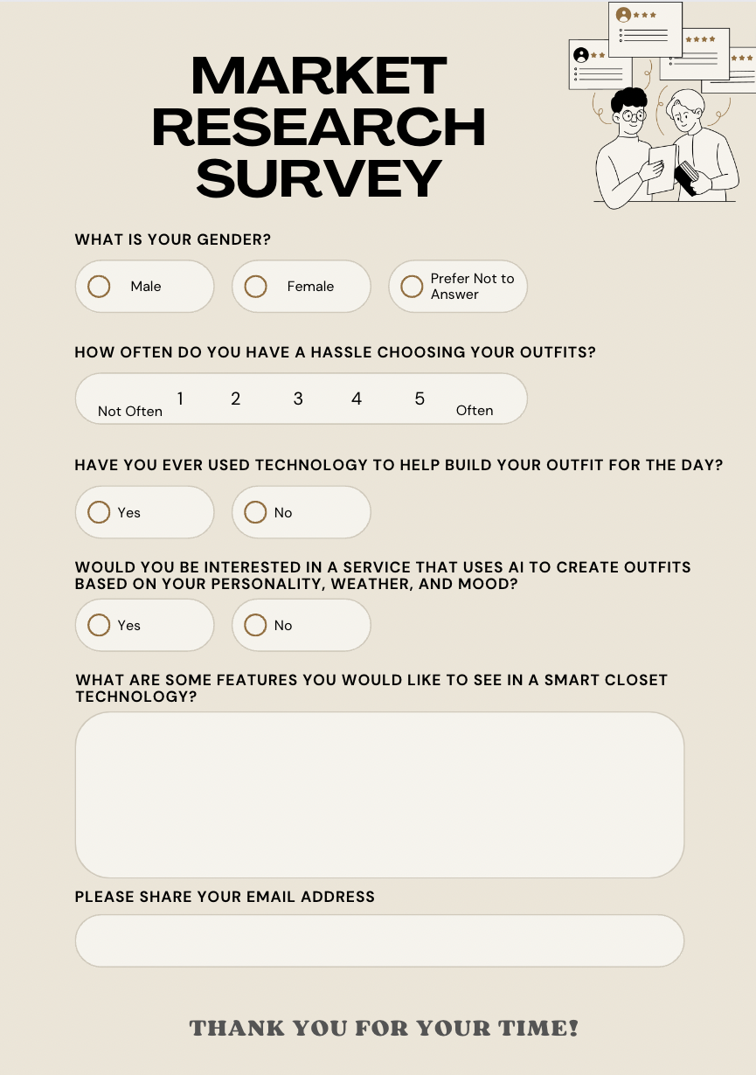
Target Market: Market Research
We plan to conduct a small, inexpensive market research by distributing a questionnaire.
The questionnaire will have 5-6 questions to understand the target group's needs and wants regarding efficiently using their time in their daily routines.

Slide 8
Marketing Mix: Product
Advanced AI closet with a similar build to a walk-in home closet
Includes a reflective mirror that can scan a person
Suggests an outfit based on mood, weather, and personal taste in clothing
Uses similar AI technology as Alexa Reflective Smart Mirror
Can be used to customize an outfit.

Slide 9
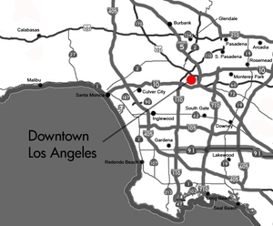
Marketing Mix: Place
Office location: Downtown Los Angeles.
Chosen for its location in the business district.
Accessible to the public by scheduling a meeting through the receptionist.
Many influencers, celebrities, and people with high income live and circulate in the area.
Downtown Los Angeles specifically has various branches that may be accessible for expanding services and inventions.

Slide 10
Marketing Mix: Promotion
Introductory stage
Growth stage
Social Media Advertising: Instagram, Tiktok, Facebook, Twitter.
Showcase unique features: Creating outfits based on personality, weather, and mood.
Market research: Effective messaging and visuals that reflect the target audience's lifestyle and interests.
Influencer Partnerships: Bloggers, YouTubers, Instagram influencers.
Different Forms: Sponsored posts, product reviews, or featuring us in their content.
Provide Reviews and Feedback

Slide 11
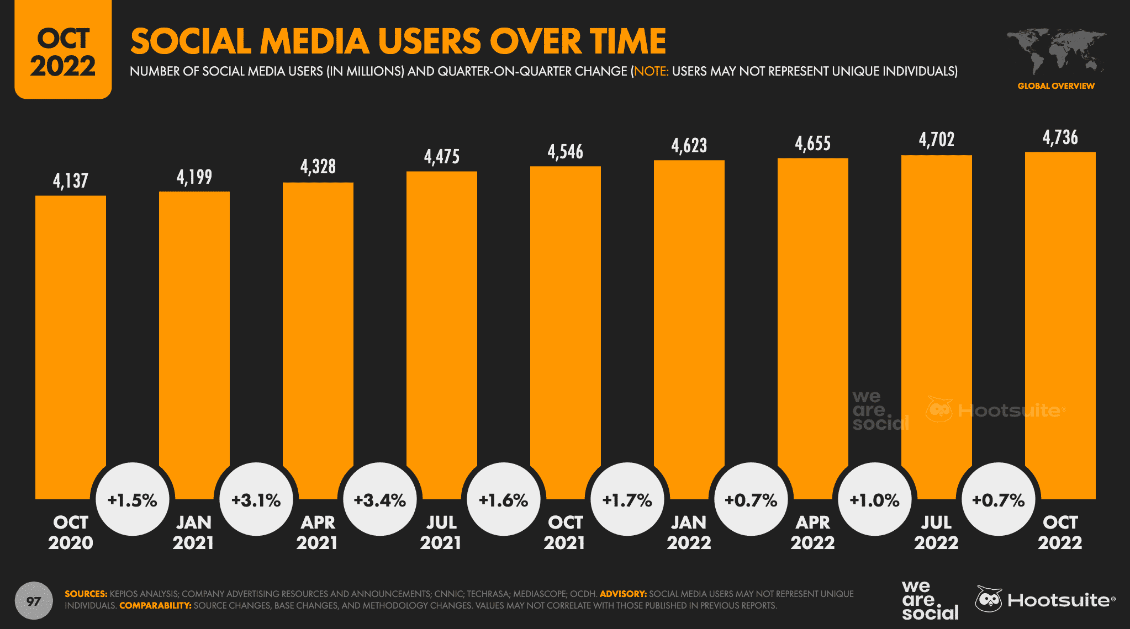
Marketing Mix: Promotion
WHY Clotech decides to choose social media advertising?
Provides a larger audience to reach.
Valuable insights to understand our target market.
Cost-effective advertising opportunities to promote our products or services.

Slide 12

Marketing Mix: Price
We plan on using the cost-based pricing which involves calculating the total cost of production and adding a markup to determine the selling price. We will add a markup of 50% or more to cover the development and manufacturing costs, as well generate a profit.
Total sales = Selling price x No. of units sold/year
Total sales = $20,000.00 x 75 = $1,500,000.00
So, using a cost-based pricing strategy with an estimated cost and expense of $500,000.00 and a minimum of 75 customers per year, we would need to charge a selling price of $20,000.00 per customer to earn a 50% profit margin and generate $1,500,000.00 in total sales per year.

Slide 13

Implementation
Develop a comprehensive website and modern app.
Build and integrate a smart closet technology solution.
Hire a team to curate outfits that meet customer needs.
Launch a targeted digital marketing campaign.
Provide excellent customer service.
Collaborate with fashion bloggers and influencers.

Slide 14


Evaluation
Monitor website traffic, sales data, & digital marketing metrics.
Conduct surveys and focus groups to gather feedback.
Monitor customer satisfaction levels through reviews & feedback.
Maintain brand name and brand loyalty.

Slide 15

Implement quality control measures to ensure Clotech meets exclusive standards.
Regularly conduct performance evaluations of team members and provide training accordingly.
Monitor the operations department responsible for order fulfillment.
Maintain a proactive approach to customer service.
Continuously update and improve the smart closet technology.
Expand brand name and loyalty through effective customer service and smart closet technology.
Control

Slide 16

What is Clotech?

