Slide 1
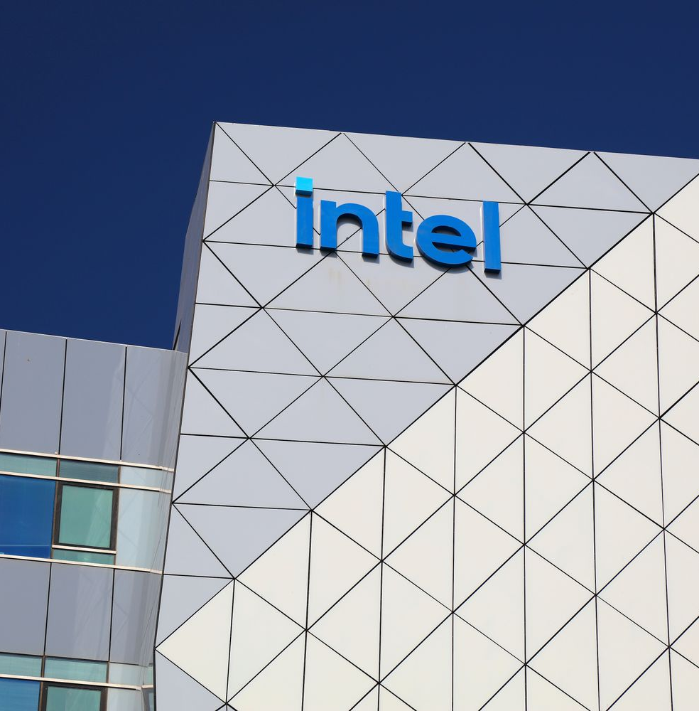
BUS 2000 REC [40760]
INTEL CORPORATION RESEARCH PROJECT
Presented by: Group 2
Marianna Roncetti da Costa, Nikita Feldman, Zihan Akther

Slide 2
BUS 2000 REC [40760]
PURPOSE & ROADMAP
  Purpose: explain why Intel’s future can be strong
  Company background
  Strategy, marketing & ESG
  Recent events
  Competition
  Revenues & stock
  Our recommendations
Next Slide

Slide 3


BUS 2000 REC [40760]
WHY SHOULD WE CARE ABOUT INTEL?
  Chips are in phones, laptops, cars, AI, cloud
  Intel is a major U.S. chip company
  U.S. government sees Intel as strategic
  Intel’s success affects jobs, innovation, and security
Next Slide

Slide 4
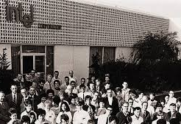
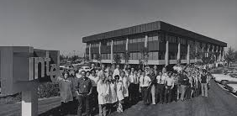
BUS 2000 REC [40760]
  Founded 1968, Santa Clara, California
  Around 108,900 employees worldwide
  Designs and makes semiconductor chips
  Serves PC, data center, networking, and automotive markets
OVERVIEW
Next Slide

Slide 5
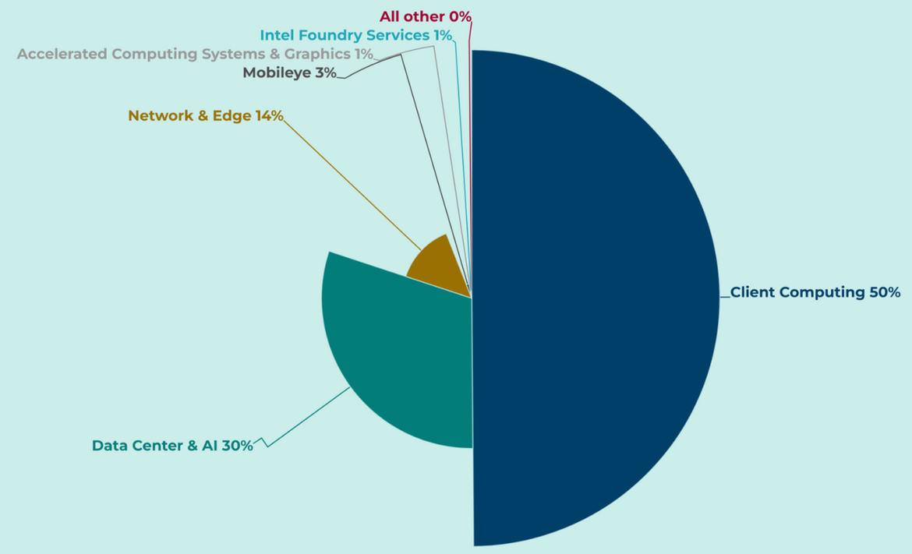
BUS 2000 REC [40760]
BUSINESS SEGMENTS
  Client Computing Group (CCG): PC chips
  Data Center & AI (DCAI): server & AI chips
  Network & Edge (NEX): networking, 5G, edge devices
  Intel Foundry: manufactures chips (for Intel + other companies)
  Other businesses: Mobileye, Altera stake
Next Slide

Slide 6
BUS 2000 REC [40760]
MISSION, STRATEGY & MARKETING
01
Mission: “Create world-changing technology…”
03
Marketing:
  Premium quality positioning
  Partnerships with Dell, HP, Lenovo
  Long-term B2B contracts for foundry clients
02
Strategy:
  Invest heavily in new manufacturing technology
  Grow AI PCs and data-center AI chips
  Expand Intel Foundry for outside customers
Next Slide

Slide 7
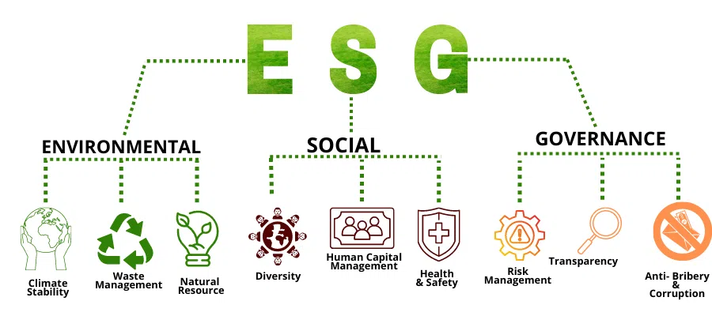
BUS 2000 REC [40760]
  ESG score around 4.5 / 5 (top 10% globally)
  Environmental: renewable energy, water & supply-chain controls
  Social: worker safety, diversity, human rights programs
  Governance: independent board, anti-corruption policies
ESG: ENVIRONMENTAL, SOCIAL, GOVERNANCE
Next Slide

Slide 8
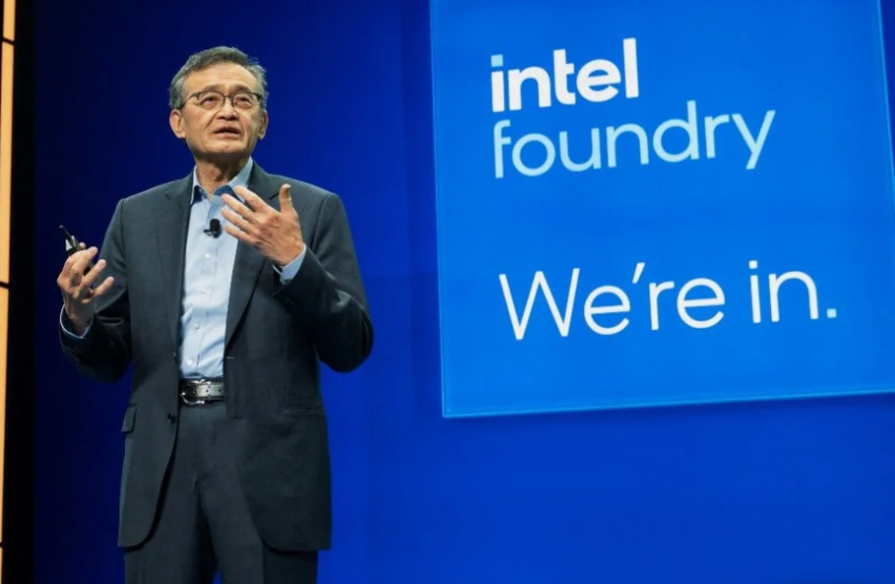
BUS 2000 REC [40760]
  U.S. government invested $8.9B for ~9.9% stake
  NVIDIA & SoftBank made multi-billion-dollar investments
  New CEO Lip-Bu Tan (semiconductor veteran)
  Sold 51% of Altera → more cash for core projects
RECENT EVENTS
Next Slide

Slide 9
BUS 2000 REC [40760]
COMPETITIVE LANDSCAPE
  AMD: strong in PC & server CPUs
  NVIDIA: leader in AI GPUs
  ARM-based chips: Apple, Qualcomm, others
  TSMC & Samsung: top chip manufacturers
  Intel advantages: scale, U.S. factories, government support, strong brand
Next Slide

Slide 10
BUS 2000 REC [40760]
REVENUE
  2023 revenue: $54.2B
  2024 revenue: $53.1B
  2025 TTM revenue: $53.4B
  Data from CFRA & Mergent Market Atlas
  Signs of stabilizing and room for future growth
Timmerman Industries
Timmerman Industries
Next Slide

Slide 11
BUS 2000 REC [40760]
STOCK PERFORMANCE
  2023 revenue: $54.2B
  2024 revenue: $53.1B
  2025 TTM revenue: $53.4B
  Data from CFRA & Mergent Market Atlas
  Signs of stabilizing and room for future growth
Timmerman Industries
Timmerman Industries
Next Slide

Slide 12
BUS 2000 REC [40760]
SWOT ANALYSIS
Strengths
Weaknesses
  Strong brand reputation in the semiconductor industry
  Diversified product portfolio across consumer PCs, data centers, and AI
  Large scale with manufacturing capabilities in the U.S. and Europe
  Partnerships with major OEMs like Dell, HP, and Lenovo
  High ESG scores, attracting responsible investors
  Lagging in advanced chip manufacturing compared to TSMC
  Slow adoption of AI chips compared to NVIDIA
  High operational costs due to new factory construction
  Heavy reliance on PC market, which grows slowly
  Supply chain vulnerabilities due to global instability
Next Slide

Slide 13
BUS 2000 REC [40760]
SWOT ANALYSIS
Opportunities
Threats
  Intel Foundry can position Intel as a leader in external chip manufacturing
  Expanding into automotive and edge computing markets
  AI and data center markets are rapidly growing
  Government investments (CHIPS Act) and support for U.S. semiconductor companies
  Potential to expand foundry services for external customers
  Fierce competition from AMD, NVIDIA, and ARM-based chips
  TSMC & Samsung leading in cutting-edge manufacturing processes
  Global supply chain disruptions (materials, production issues)
  Fast-moving AI innovation from competitors
  Geopolitical risks with heavy reliance on Chinese market
Next Slide

Slide 14

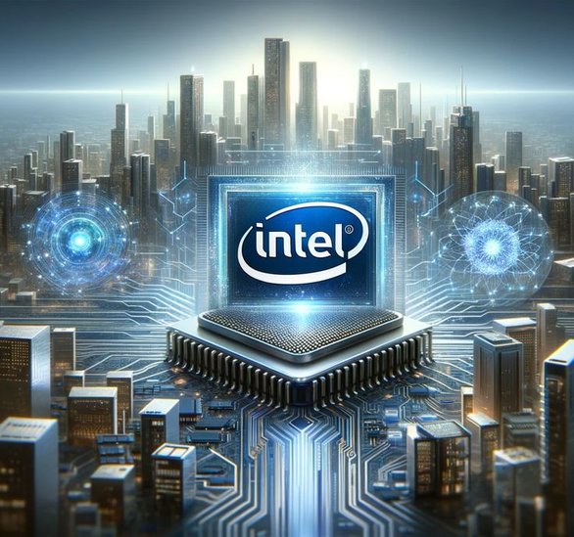
BUS 2000 REC [40760]
RECOMMENDATIONS
Short-Term (next 1–2 years)
  Focus on making new factories efficient (raise yields)
  Continue improving AI chips and software tools
  Strengthen marketing for AI PCs with OEM partners
Long-Term (3+ years)
  Build a strong customer base for Intel Foundry
  Expand into automotive and edge-computing chips
  Keep investing in ESG to maintain trust
Next Slide

Slide 15
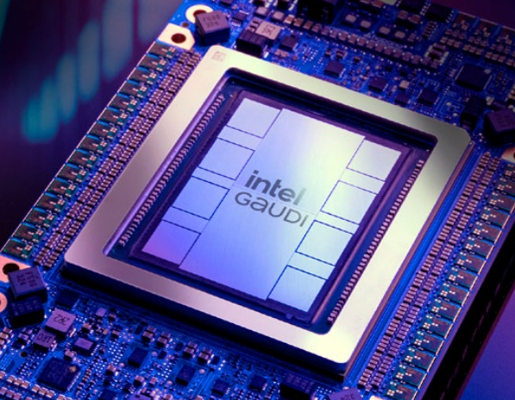
BUS 2000 REC [40760]
  Faced real challenges, but revenue is stabilizing
  Backed by governments, investors, and new leadership
  Positioned for growth in AI, advanced manufacturing, and foundry services
  Overall message: Intel today is laying the groundwork for stronger performance tomorrow
CONCLUSION
Next Slide

Slide 16
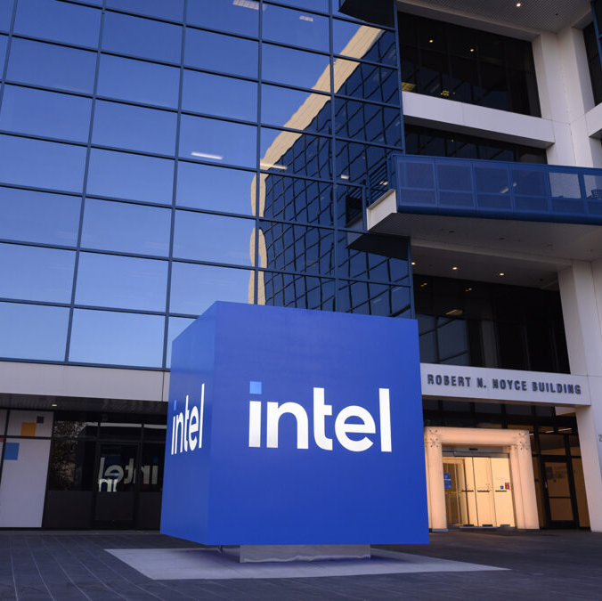
BUS 2000 REC [40760]
THANK YOU
Next Slide

