Slide 1

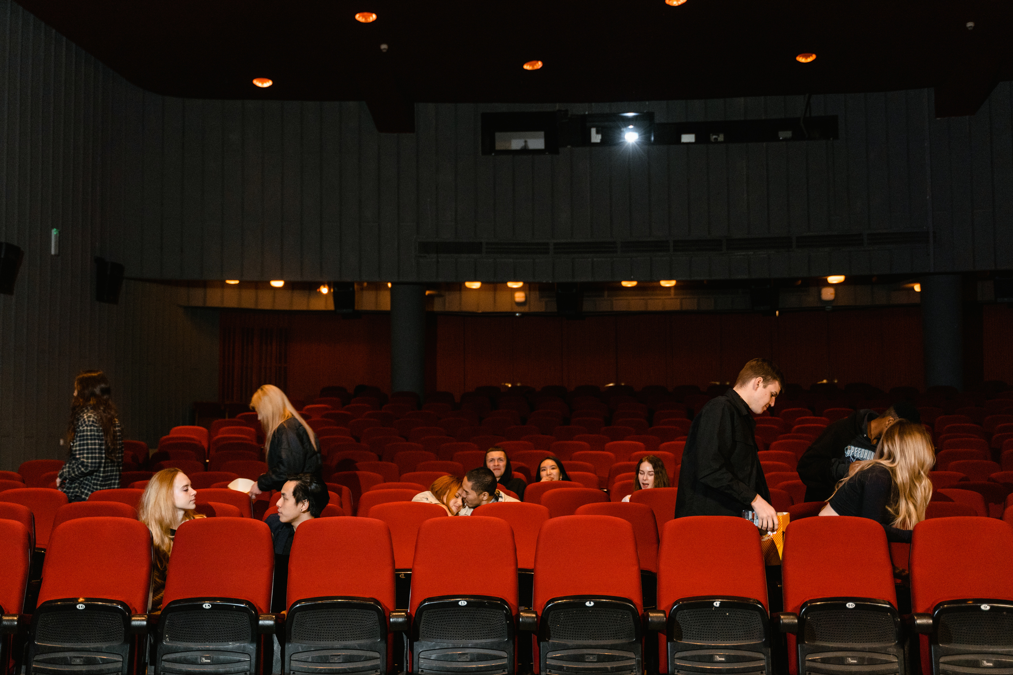

MKT 4593 | Baruch College
Group 5: Elizabeth F, Janice L, Kristopher M, Riyadh S, Zihan A
CRAFTING A WINNING DIGITAL MARKETING STRATEGY (PART 3)
NETFLIX
START SLIDE

Slide 2
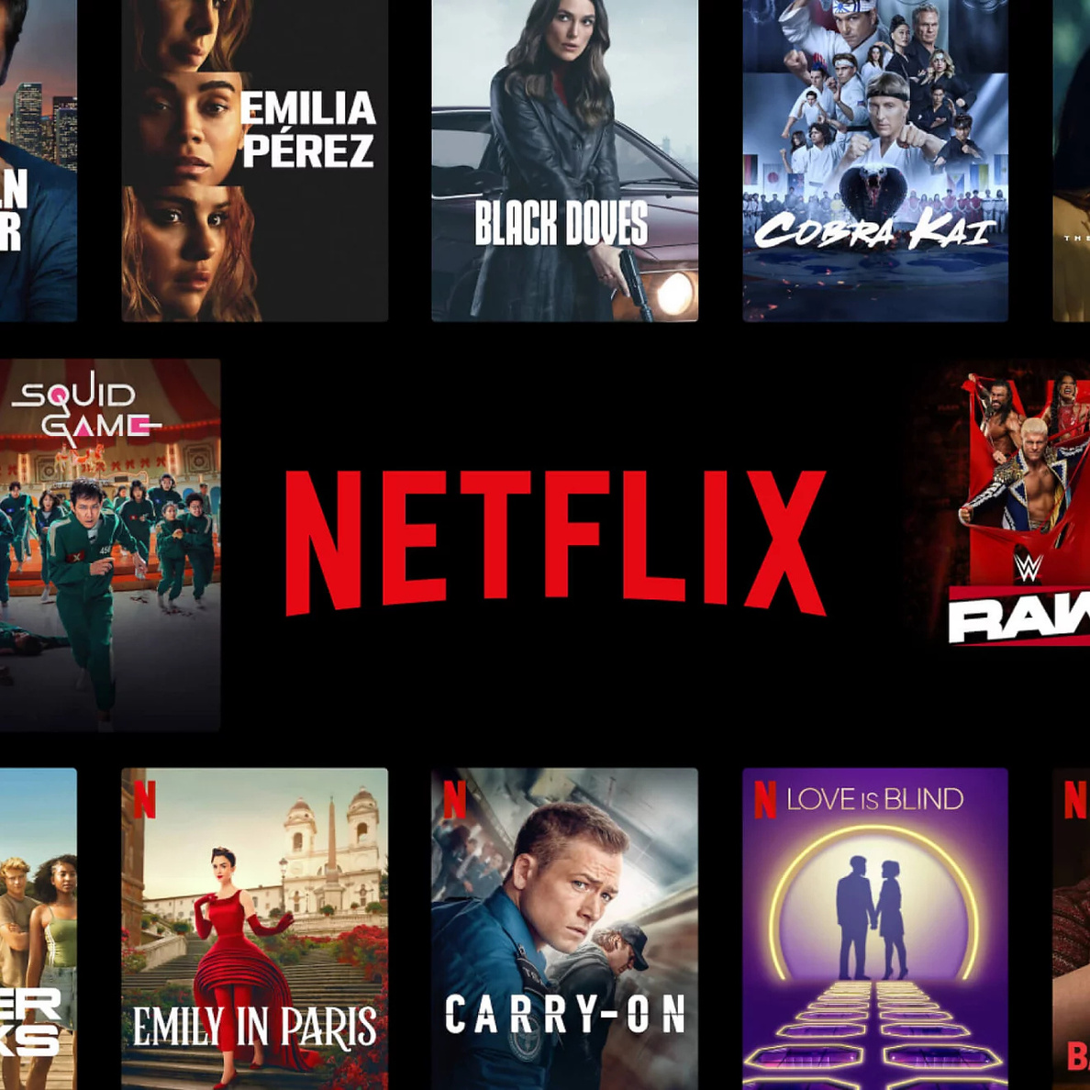
NETFLIX
  Founded in 1997 as a DVD rental service
  Transitioned to streaming service in 2007
  260m+ subscribers across 190 countries
  30+ languages, top shows in every continent
  Personalization powered by ai algorithms

Slide 3
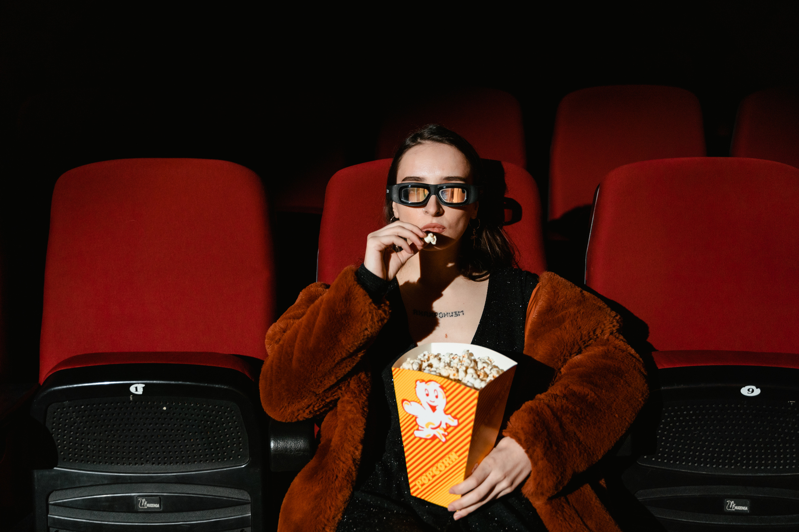
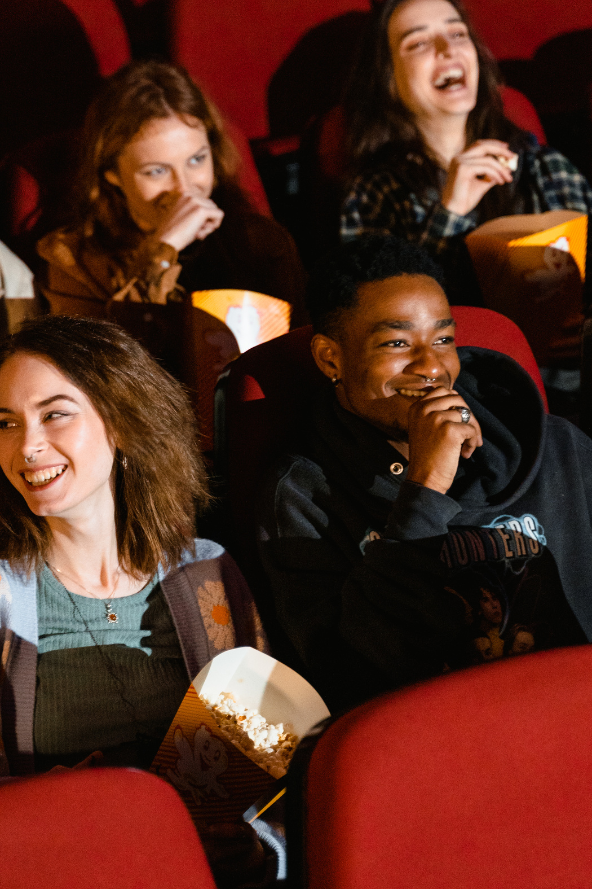
AUDIENCE
  TECH-SAVVY GEN Z & MILLIENIALS
    Streaming is a default habit
    Multi device viewers
    Social sharing habits result in a high potential for viral content
  LOW-HIGH INCOME INDIVIDUALS
    Bigger customer pool.
  INDIVIDUALS LOCATED IN URBAN AREAS
    More opportunities for interactive social media content creation with consumers
    Higher conversion via word of mouth, more social media buzz or trends clusters
    Region is more like to have connectivity, cultural influence, and audience density

Slide 4
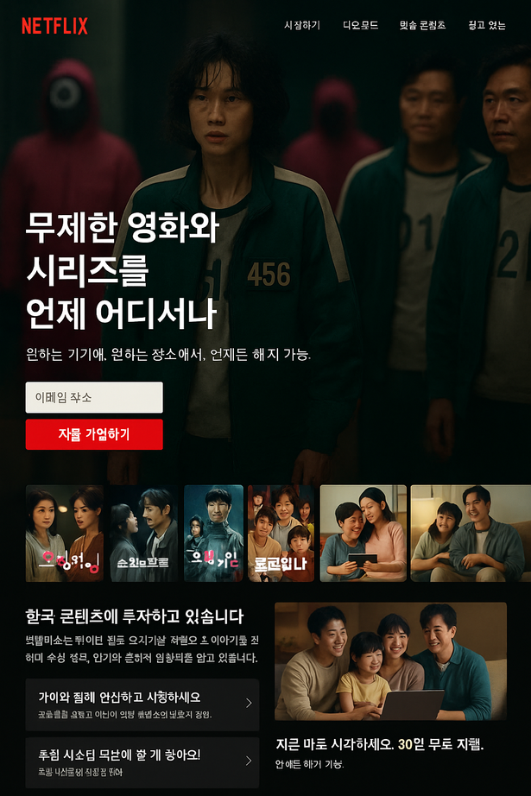

WEBPAGES
SOUTH KOREA
  Highlight: K-Dramas like Squid Game, Crash Landing on You
  Korean-language banner headline: “무제한 영화와 시리즈를 언제 어디서나”
  Design: Netflix red/black + warm neutrals, clean layout with white space
  Features: Local reviews, dubbing/subtitles, mobile-optimized experience

Slide 5
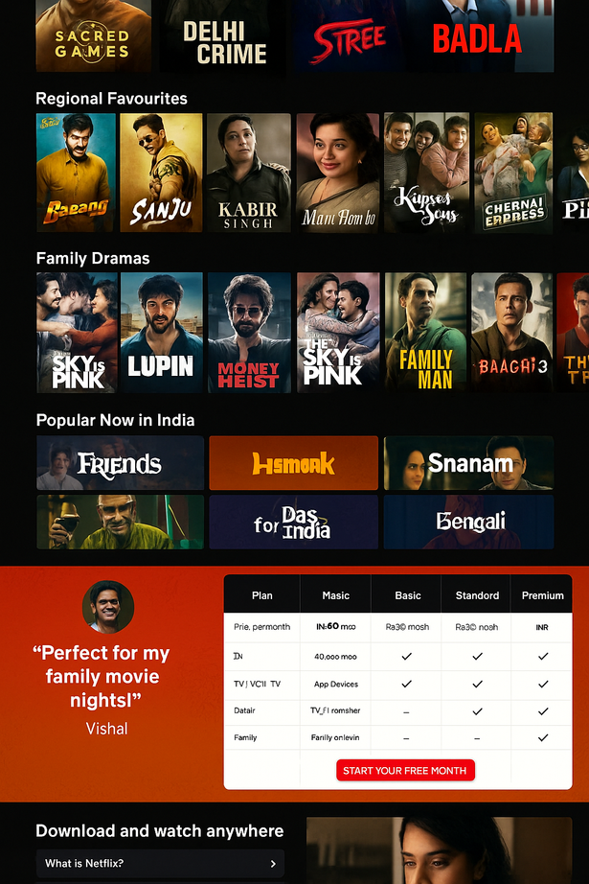

WEBPAGES
INDIA
  Highlight: Indian originals (Sacred Games, Delhi Crime), regional films (Tamil, Telugu)
  Quote blocks from Indian celebs and critics
  Design: Jewel tones (gold, maroon, peacock blue), authentic family and youth visuals
  Features: UPI payment options, regional trending tabs
Shared SEO Approach
  Local search terms: “Best Netflix shows in Tamil” / “Top Korean dramas 2025”
  Schema markup for trailers, reviews
  Hreflang tags for regional search engines
  Fast-loading, mobile-first pages
  Local backlinks from blogs, forums, media

Slide 6
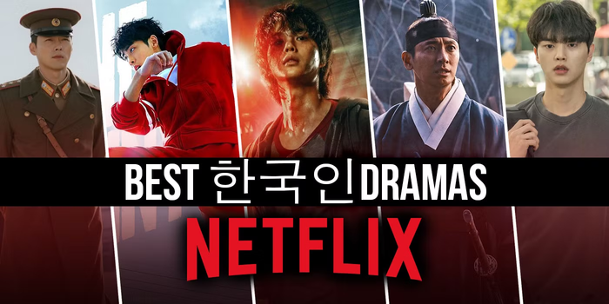

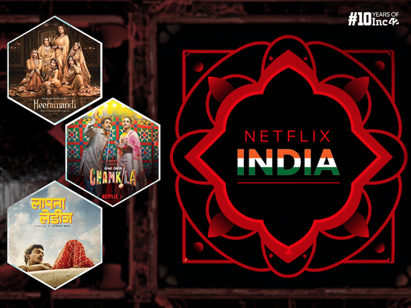
SOCIAL MEDIA CAMPAIGN
SOUTH KOREA
  Campaign: #CryWithMe
  TikTok: Emotional K-Drama reaction challenges
  Instagram: Carousel – “5 Netflix Shows That’ll Break Your Heart”
  Influencer collabs with local Korean creators
  Focus on emotional storytelling, aesthetics
Performance Metrics
  Engagement rate (likes, shares, comments)
  Hashtag usage & user-generated content
  Click-through rates to app or site
  Trial signups and conversions by region
INDIA
  Campaign: Netflix & Diwali
  Instagram: #NetflixRituals (binge habits, memes)
  YouTube: Netflix & Me – short user stories
  Celebrity content featuring stars like Ajay Devgn
  Visuals: Rangoli, diyas, festive themes

Slide 7





COMPETITIVE ANALYSIS
FEATURE
ORIGINALS STRENGTH
VERY HIGH
MEDIUM
HIGH
MEDIUM
GLOBAL REACH
VERY HIGH
MEDIUM
HIGH
MEDIUM
PRICE FLEXIBILITY
MEDIUM
LOW
VERY HIGH
MEDIUM
FAMILY CONTENT
MEDIUM
VERY HIGH
MEDIUM
MEDIUM
USER EXPERIENCE
VERY HIGH
HIGH
MEDIUM
HIGH

Slide 8


DISPLAY ADS
AD CONTENT STRATEGY
VISUALS:
  Eye-catching stills from hit k-dramas & Korean films
  Include popular actors, k-pop stars, & Netflix originals
MESSAGING:
  Highlight exclusive content only on Netflix
  Emphasize flexibility: watch anytime, cancel anytime
  Clear, catchy slogans in Korean
CULTURAL FIT:
  All ads fully localized in Korean
  Use slang, hashtags, and references that click with Korean audiences

Slide 9
HYPERLOCAL MARKETING
WHY HYPERLOCAL?
These days, non-metropolitan, culturally distinct markets are the source of growth.
Higher conversions are the result of localized language, content, and payment.
Increases trust by being relevant and familiar
HOW TO EXTEND?
Pay attention to localities WITH LARGE DENSITIES (SUBURBS, TIER-2 CITIES, ETC.)
Make use of local events, language, and area creators.
Localized app ui and geo-targeted advertisements
KEY METRICS:
Trial and click-through rates for local advertisements.
Region-specific watch time.
Use of local hashtags and user-generated material.

Slide 10
MEASUREMENT REPORTING
Customer Touch-Point | Organic KPI | Paid KPI | Attribution / Outcome KPI | Why It Matters
Netflix Web Pages | Avg. Scroll Depth, Time-on-Page | — | Bounce Rate, Page-to-Play Rate | Shows if visitors stay and click Play.
Netflix App | Daily Active Users (DAU) | — | Minutes-Streamed per Session | Indicates member usage and depth of viewing.
OTT Carousel (in-app hero) | — | Click-through Rate | Add-to-My-List Rate | Reveals immediate watch intent from the home screen.
YouTube | View-through Rate (organic) | View-through Rate (paid) | Watch-Time Percentage | Tests creative strength.
Instagram | Saves and Shares | CPM Reach | Comment Sentiment | Measures reach and cultural fit.
Twitter / X | Earned Impressions | Click-through Rate on Sponsored Tweets | Hashtag Velocity | Tracks buzz and ad clarity.
TikTok | User-Generated Clip Rate | Ad Completion Rate | Duet Frequency | Confirms viral appeal.
Web Search (Google / Naver) | Top-10 Organic Click Share | Search Ad Click-through Rate | Average Position, Dwell Time, Blog Read-Depth | Shows how easily audiences find us.
Geo-fenced Mobile Ads | — | Impressions and Click-through Rate | Cost per Trial, Visit-Lift Percentage | Tells if local ads drive trials efficiently.
Trial / Subscription | — | — | Free-Trial Start Rate, Trial-to-Paid Conversion | Direct link to revenue growth.

Slide 11
THANK YOU
NETFLIX

